Slide 1
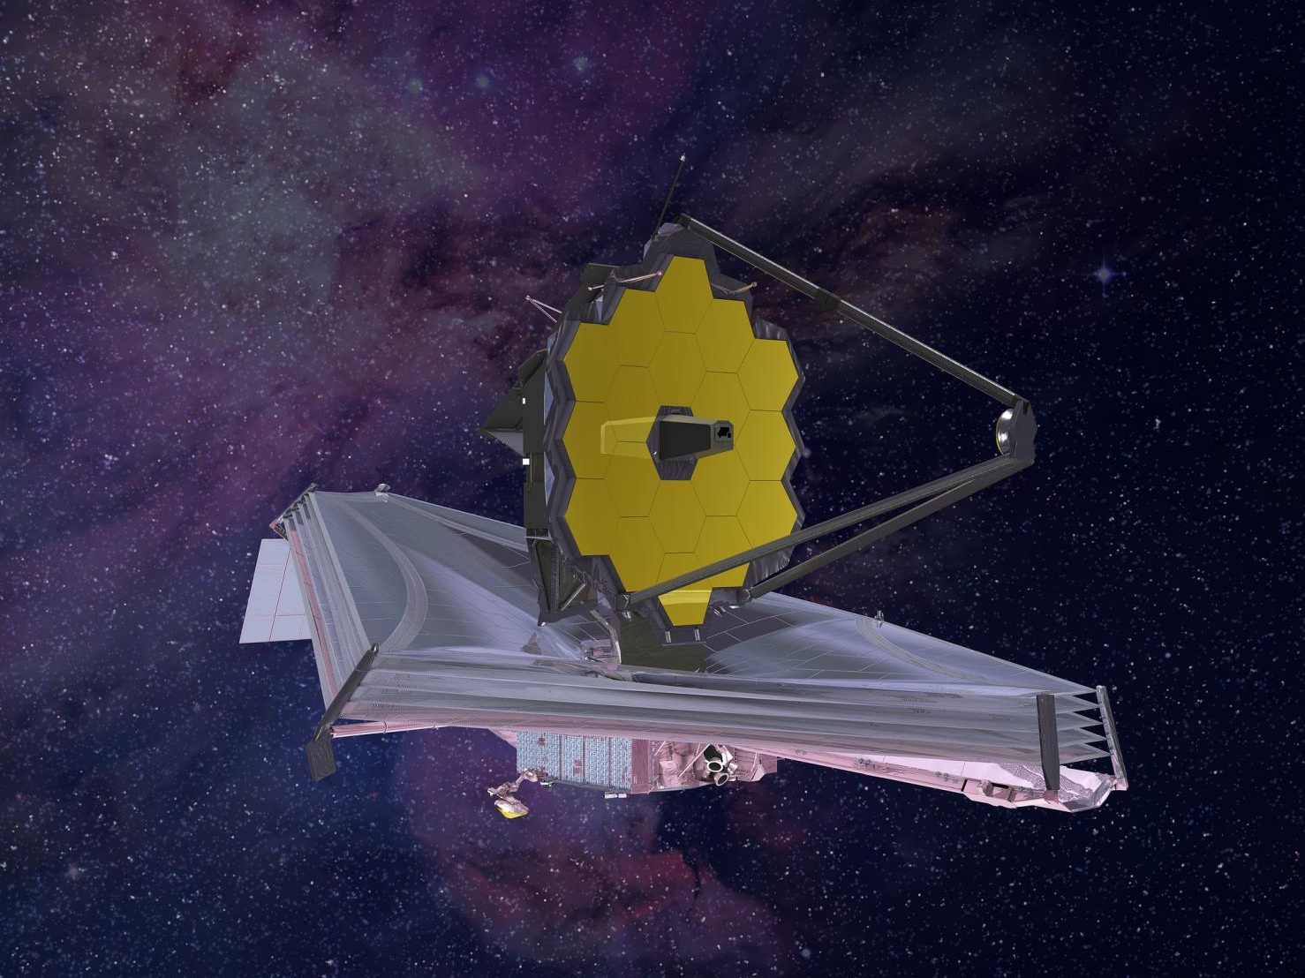

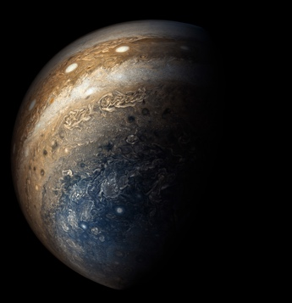
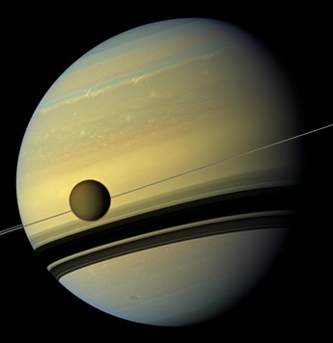
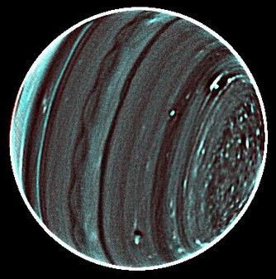
The JWST Giant Planet Atmospheres Programme
Leigh N. Fletcher
Heidi Hammel, Stefanie Milam,
Imke de Pater, Thierry Fouchet, Glenn Orton, Michael Roman,
Naomi Rowe-Gurney, Henrik Melin, Michael Wong, Patrick Fry,
Arrate Antuñano, Ricardo Hueso,
Matthew Tiscareno, Patrick Irwin, Julianne Moses, Bryan Holler,
John Stansberry, and Alistair Glasse

Slide 2

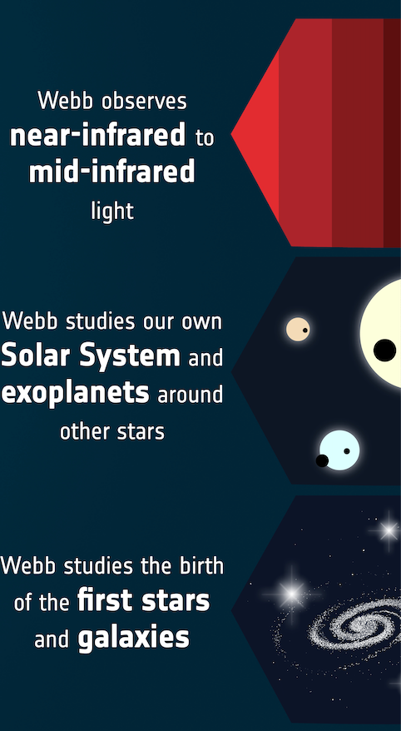
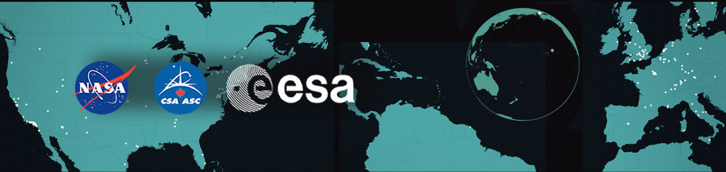
The Rise of JWST
Premier observatory for the 2020s.
International collaboration
Revolutionising views of cold, distant targets.
Opens up spectroscopic mapping of giant planets with a sensitivity that is unsurpassed.

Slide 3
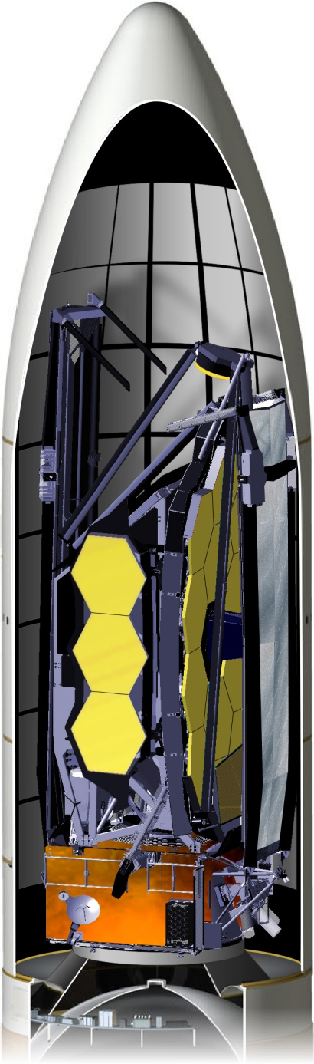
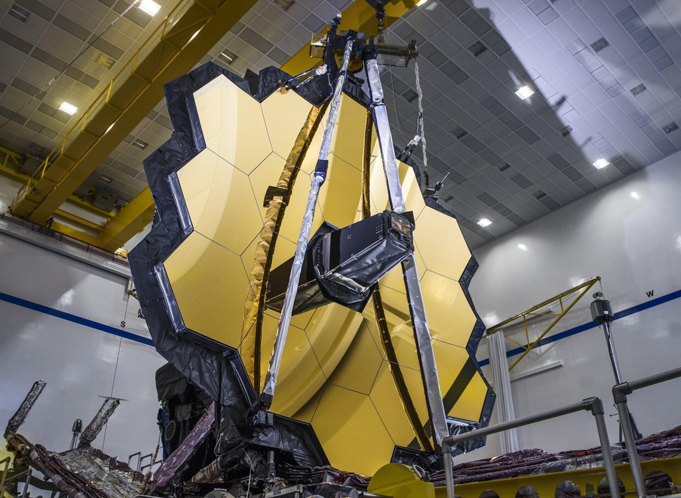
The Rise of JWST
Launch: Ariane 5, 2021; 6200 kg.
Orbit: L2, 1.5 million km.
5-layer sunshield to operate at <50K, deploys in week 1.
Hexagonal 6.5m mirror, 18 beryllium segments, offering 0.1 arcsec (optical).
Timeline:
Month 1: Telescope deployment, cooldown, instrument turn-on, and insertion into orbit around L2.
Months 2-4: Initial optics checkouts, telescope alignment.
Months 5-6: Calibration and completion of commissioning.
Month 6+: Science in Cycle 1!
NASA/C. Gunn, April 2020

Slide 4
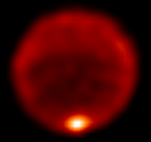
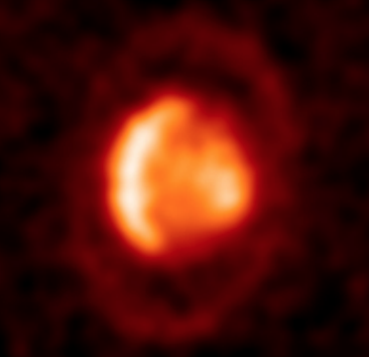
IFU Spectroscopy – Beyond Mid-IR Imaging
[GTO, ERS, GO]
Saturn 7.9/17.6 µm
Jupiter at 8.6/10.8 µm (Fletcher+2017)
Summer hemisphere MIRI (5-16 µm) mosaic; impact/storm ToO for MIRI & NIRSPEC (1.6-16 µm)
(Fletcher+2017)
[1247, 1424]
Neptune 7.9 µm
(Sinclair+2020)
Uranus 18.7 µm
(Roman+2020)
Mosaic of GRS and S. polar region (NIRSPEC & MIRI, 1.6-11 µm); NIRCAM wind maps; impact/storm ToO for MIRI & NIRSPEC (1.6-11 µm)
[1248, 1249, 1604]
Global maps of troposphere, stratosphere, ionosphere (NIRSPEC & MIRI, 1.6-29 µm); temporal variation on Neptune (MIRI)
[1246, 1424, 1373]

Slide 5
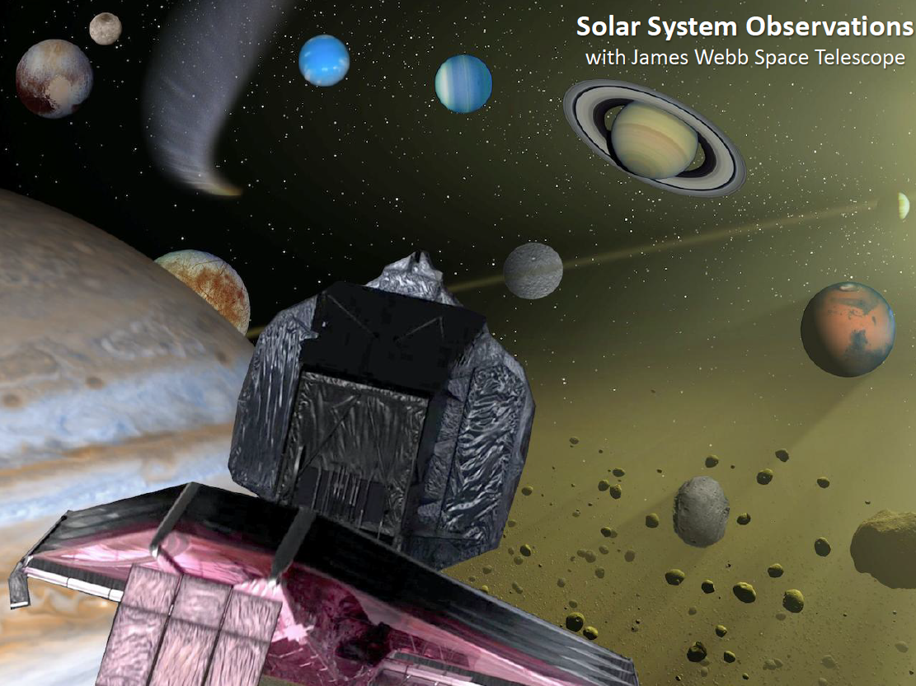
Aims of the JWST Giant Planets Programme
Science:
Baseline for time-series atmospheric analysis over the 10 years of JWST.
New discoveries in dark & hidden spectral regions.
Comparative planetology of four giants with identical spectral modes.
Capabilities:
IFU mapping capabilities for extended, rotating, moving objects.
Calibration of very bright targets near saturation.
Resource for community in Cycle 2 planning.
Engagement:
Bring in professional and amateur community to provide supporting temporal, spatial, spectral context.
!!! EPSC Splinter Meeting 24/09 17:30CEST !!!

Slide 6
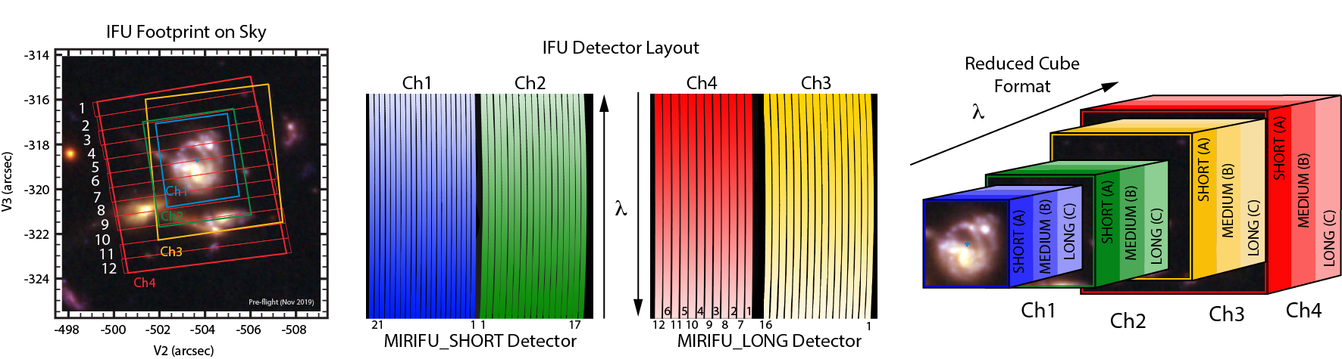
MIRI/MRS Spectroscopy
4 channels/sub-bands
2 detectors (SW = channels 1,2, LW= channels 3,4)
3 dispersers = (SHORT/MEDIUM/LONG, aka A/B/C)

Slide 7
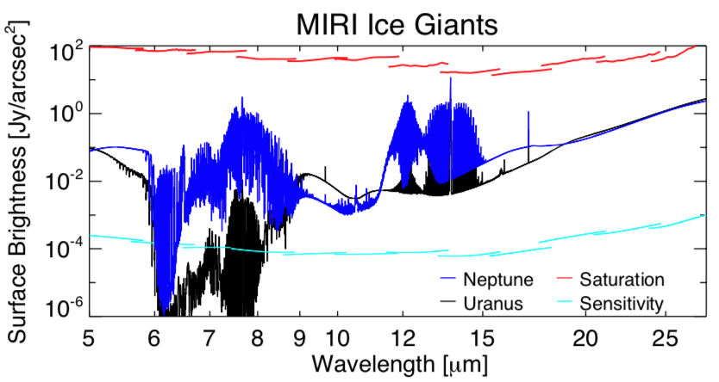
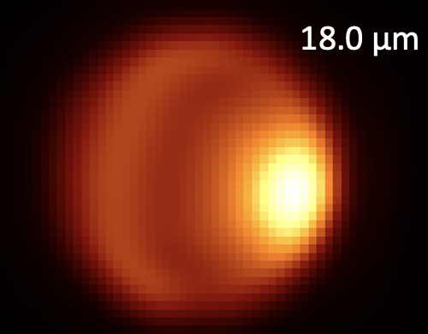
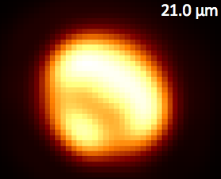
Neptune & Uranus - MIRI
CH₄
H₂O, NH₃?
C₂H₆
CO₂
H₂
CH₃D
PAHs?
H₂-He
Map tropospheric & stratospheric temperature & composition.
Synthetic spectrum using MRS resolution & 12 sub-bands, 0.1”/px.
Synthetic MIRI cubes passed to ETC and MIRISim.
H₂
C₃H₄, C₄H₂
C₂H₂
C₂H₄

Slide 8
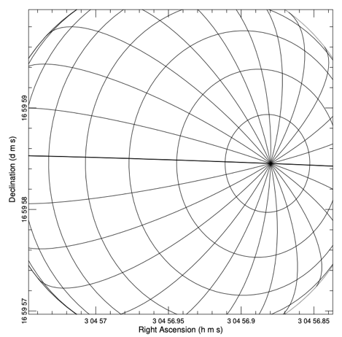
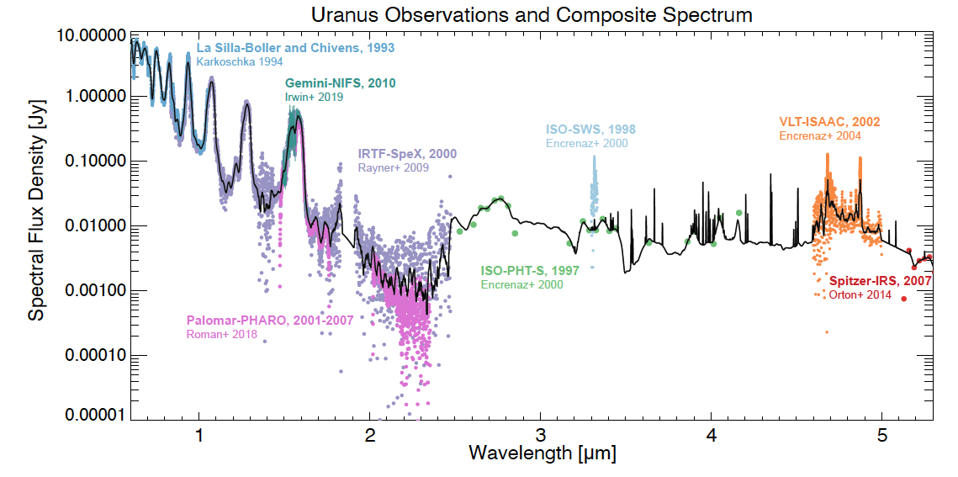
Neptune & Uranus - NIRSPEC
Map clouds (meteorology & dynamics) and ionospheric emission (H₃⁺, CO, CO₂, CH₄).
Possible first detection of Neptune H₃⁺?
30 slices:
0.1" wide and 3" in length on the sky
dither for image reconstruction.
H₃⁺ from Melin+2019
[J]
[H]
[K]
[L]
[M]
G140H/F100LP
G235H/F170LP
G395H/F290LP
(R=2700, two gratings)

Slide 9
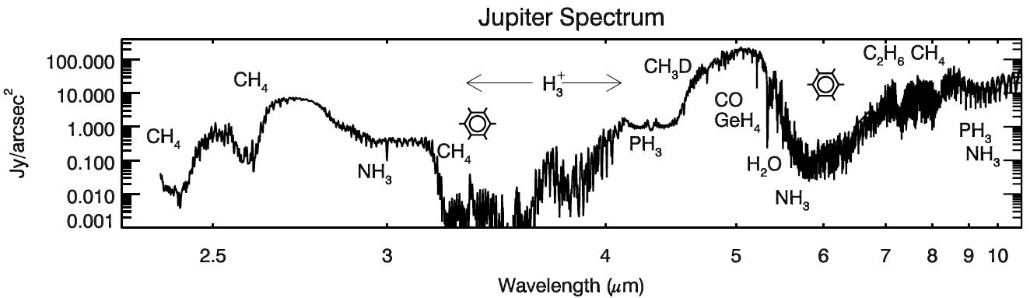
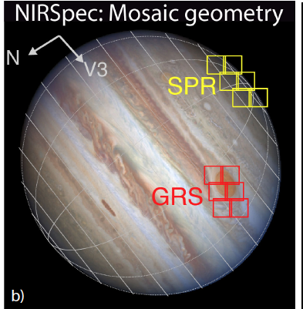
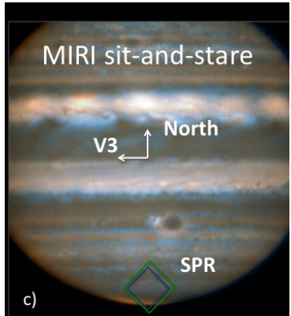
Jupiter – Giant Storms and Polar Phenomena
NIRSPEC
MIRI
MIRI and NIRSPEC mosaic of GRS.
Rotational mosaic of south pole (aurora & stratosphere)
GO: ToO for impacts/storm

Slide 10
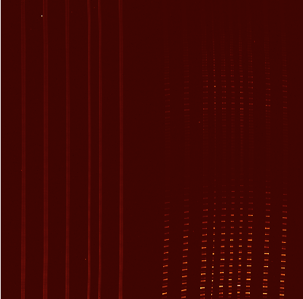
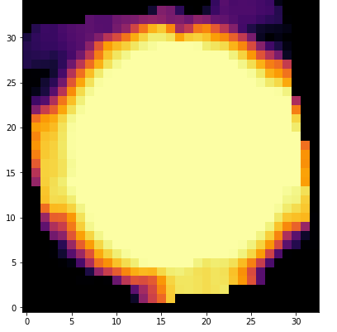
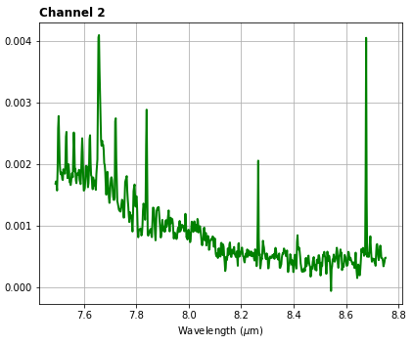
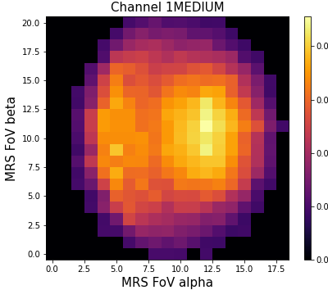
How? Data Simulation Toolkit – MIRI Example
Step 1: Synthetic cubes (NEMESIS models).
Step 2: MIRISim produces detector images.
Level 1 - detector ‘ramp’ images with PSF and noise incorporated.
Step 3: JWST Cal pipeline:
Level 2A/B - ramps to calibrated slope images Slopes”)
Level 3 - combine dithers into the final cubes 'dither*s3d.fits’
Step 4: Navigate Images:
Assign backplane geometry to each dither/mosaic tile.
Cylindrically map & extract spectra.
Step 5: Spectral retrieval
T, composition, aerosol maps
Slope image: One detector, two channels
Collapsed output cube (single dither)
Input sky cube (collapsed, single dither)
Extracted spectrum

Slide 11
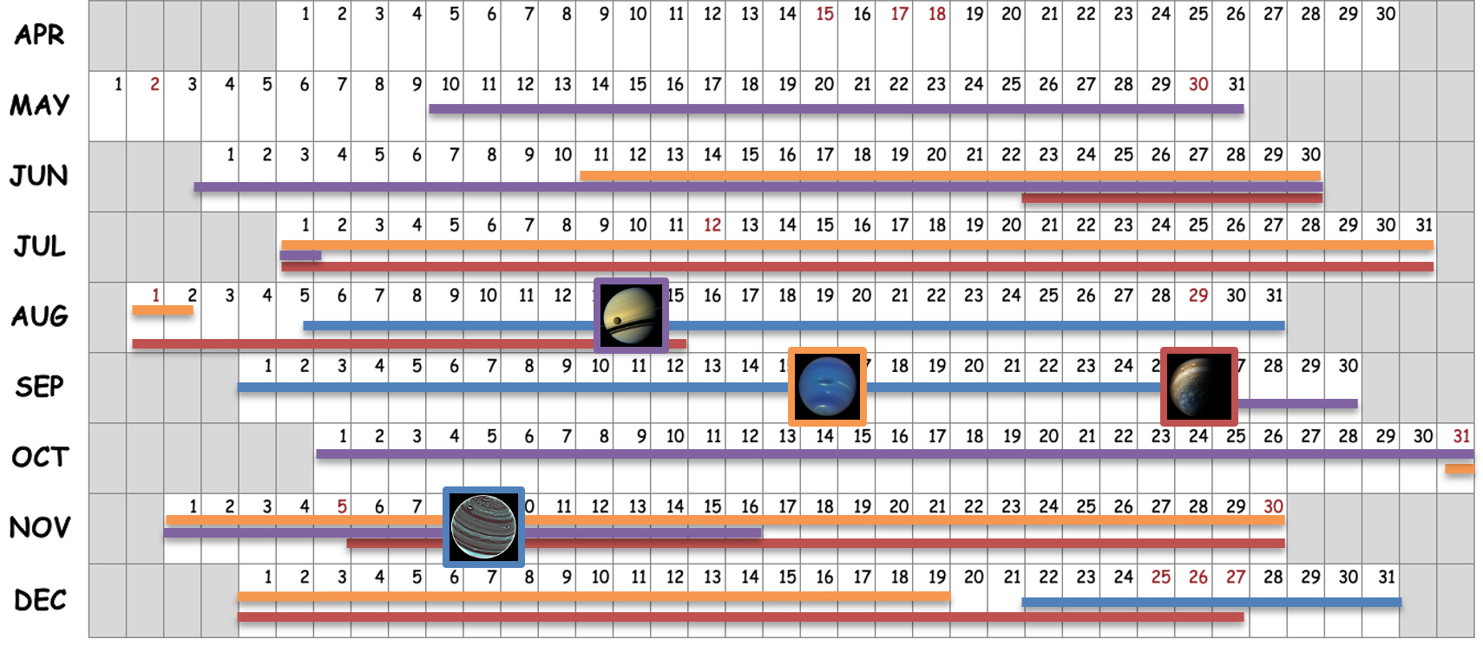
When? Giant Planets Calendar 2022
Observations only possible when target in Field of Regard either side of opposition.
KEY

Slide 12
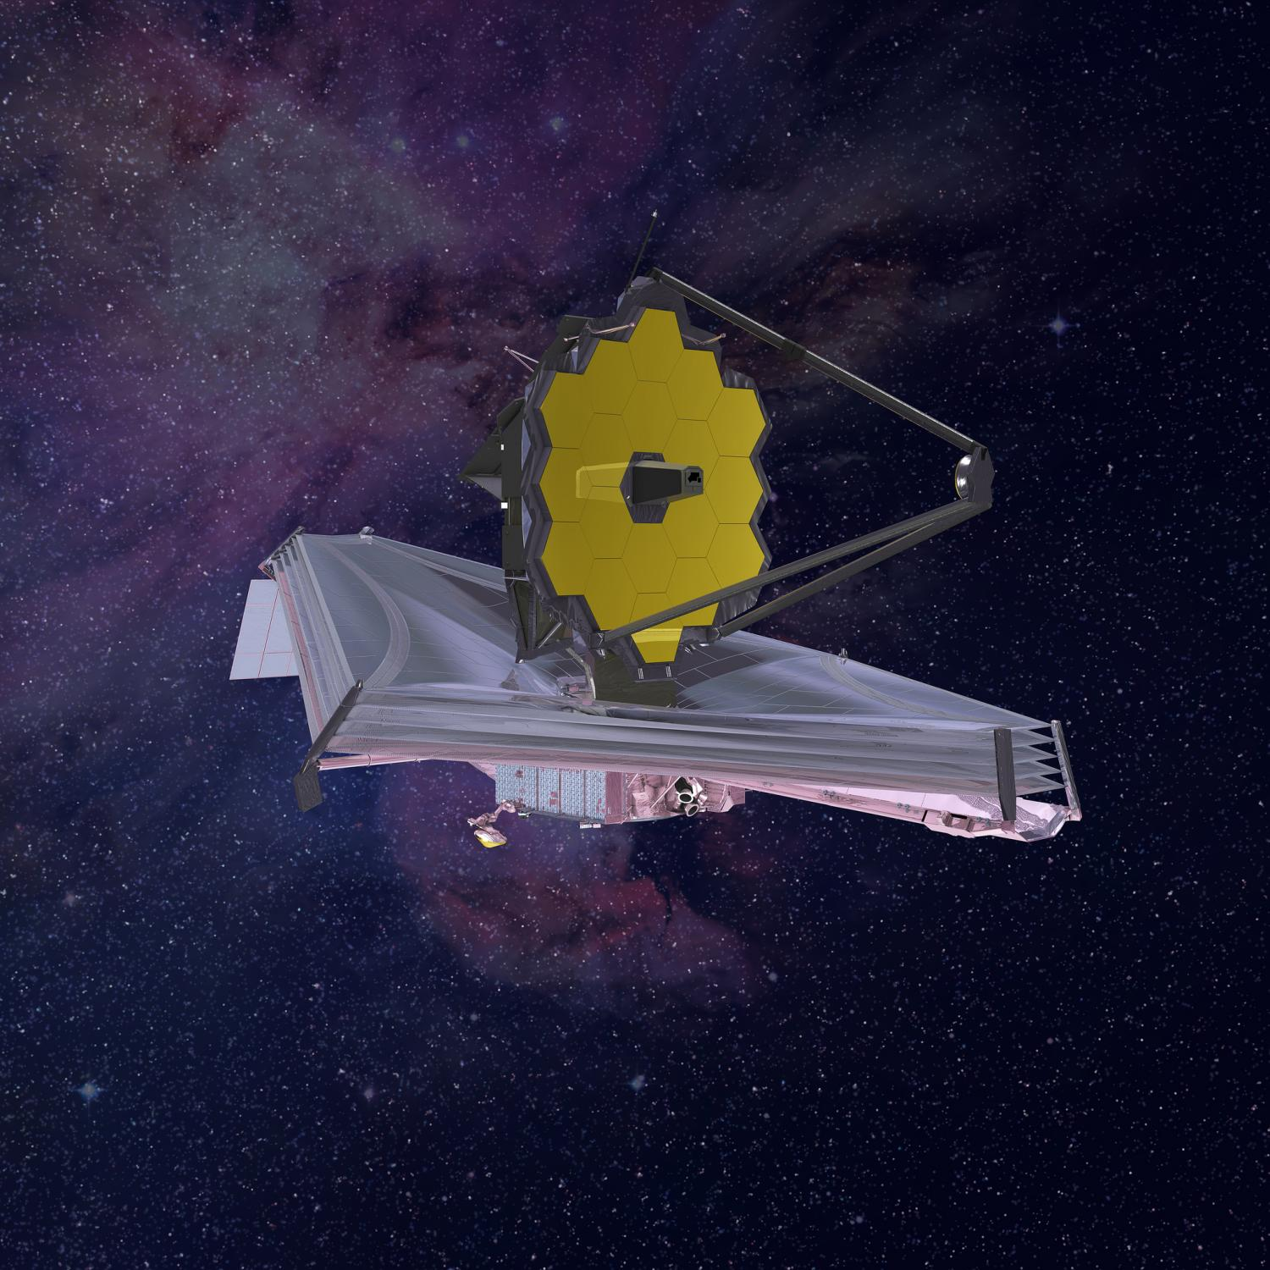

Summary and Conclusion
1246 1424 1373
JWST opens up:
New era of comparative planetology.
Spectral mapping of giant planets with a sensitivity that is unsurpassed.
Challenge:
NIRSPEC 1.6-5.3 µm and MIRI 5-29 µm spectral maps as a test of capabilities.
Mosaics of bright, extended, moving targets close to saturation limit!
Start of a long-term legacy programme for the Ice Giants ahead of future missions in the 2030s?
@LeighFletcher
1247 1424
1248
1249 1604

